Slide 1
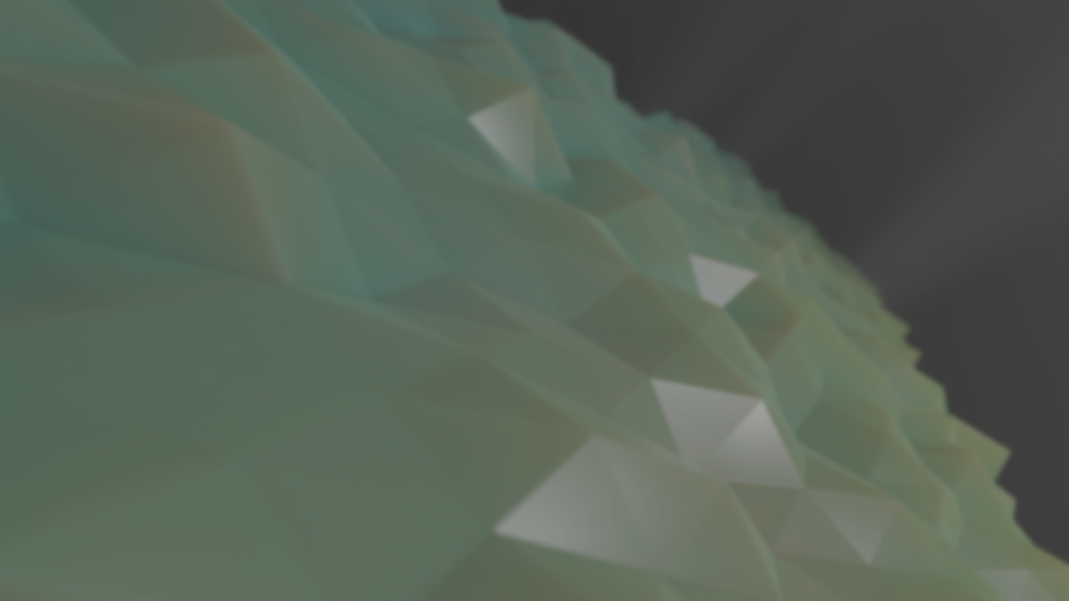
Making 3D Assets in a Game-Ready Production Pipeline
1
Immersive Technologies
Rob Blofield, MA – Senior Lecturer in Digital and 3D Design

Slide 2
Overview
This series targets ultra-optimised assets with a high poly to low poly sculpting workflow, asset grouping and unwrapping for optimised use of texture space.
The overall goal will be to work through the whole process of modelling/sculpting, texturing and optimising a stylized game asset towards a specific art direction. The sessions are outlined below
Session 1 – Model/Sculpt the asset including all detail (High poly)
Session 2 – Retopo and UV unwrap the model (low poly)
Session 3 – Bake and create smart materials to texture the model in Substance painter
Session 4 – Create a second model (more complex) following this pipeline
Session 5 – Combine the two assets, re-unwrap, re-bake and apply the smart materials into one optimised set of texture maps for both objects.

Slide 3
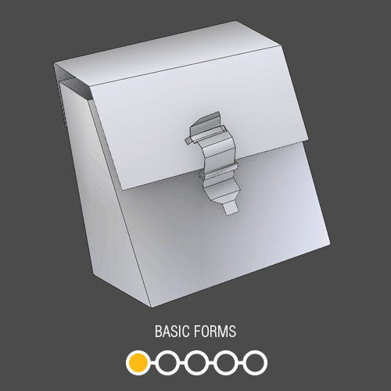
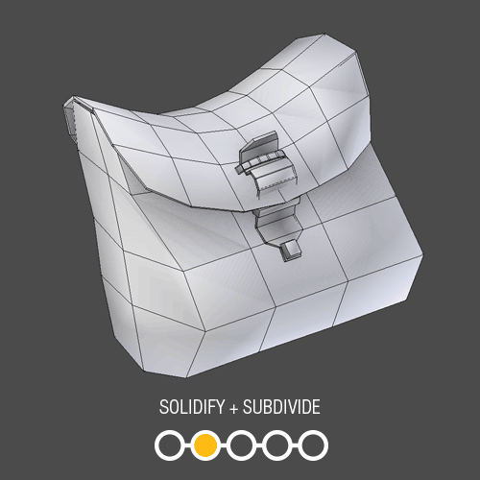
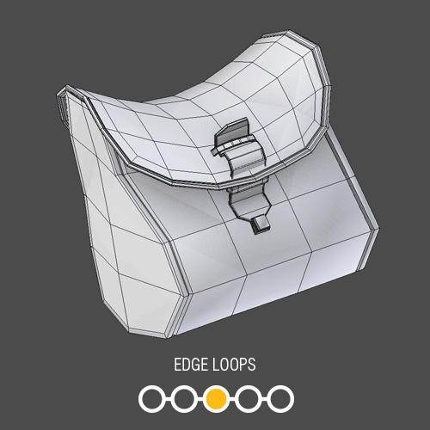
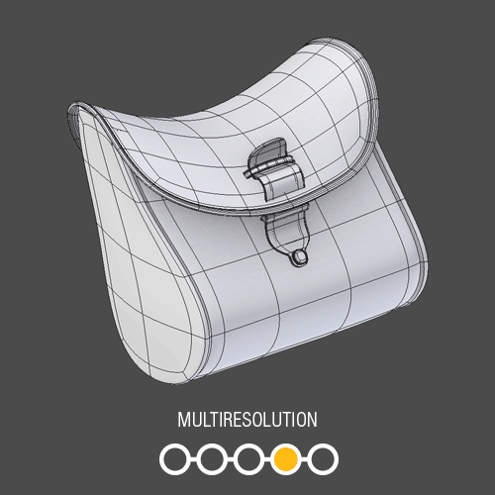
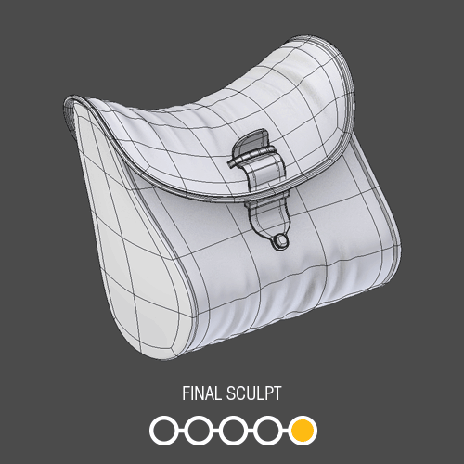
High Poly to Low Poly Overview
A confusing thing to note is that when working from high poly to low poly, we usually still start low poly
Sometimes the final sculpted details change the shape too much, or the previous stages are too high poly for their intended output.
In which case we adapt, reduce, or remake (retopologize) the mesh.
In either case, we bake down the details in the high poly down to the low poly

Slide 4
How Many Polygons? What resolution Textures?
How do I know the number of polygons and texture sizes needed for an object?
All depends on context – what is the limiting factor?
A mobile game might need assets to be low poly, it will certainly have lower resolution and fewer numbers of textures to limit download size.
A AAA title will have 10’s of Gigabytes in data from textures, audio, voice recordings, etc. Polygons may be up to 120k triangles for a main character, 250k for a car in a driving game, 25K for a prop
Almost every time each object will have just 1 shader that covers all surfaces with highly optimised textures.
Best practice is to pair objects likely to appear together with one single texture map so that they share shaders and texture files for better optimisation.

Slide 5
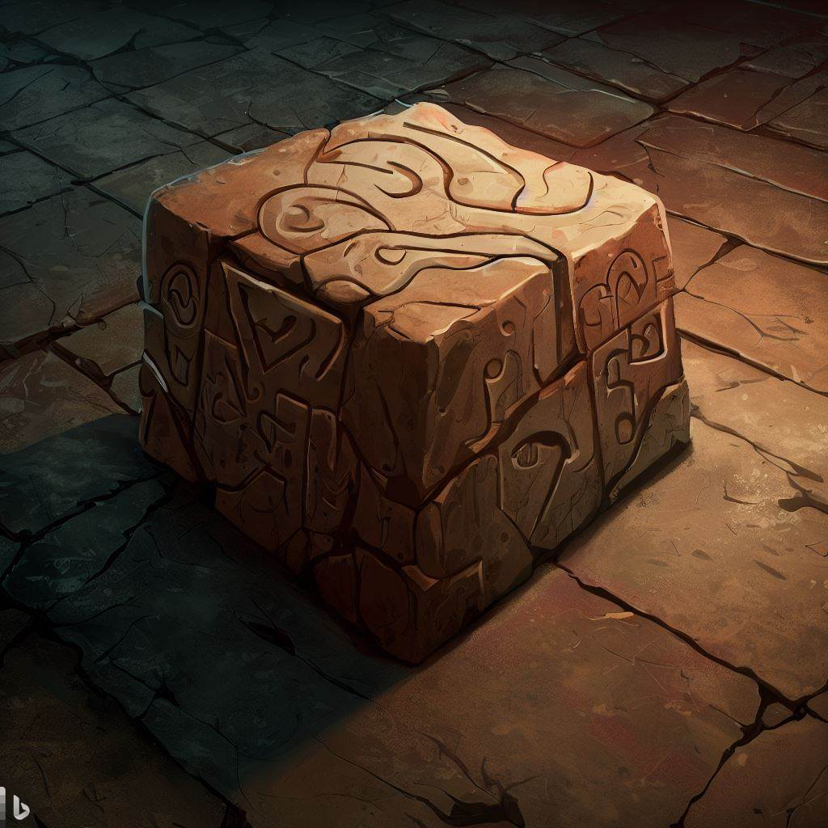
What are we making? Stylized Stonework
Why?
Because the methods used here will enable you to work on stylized stone, wood, metal, gems etc that 80% of the assets needed in the stylized genres call for.
Why stylized?
AI and pre-built tools and libraries such as Metahuman and Megascans etc are quickly making the need for skilled work and optimisation in high fidelity games obsolete.
What can’t AI do?
3D models of stylised, characterful, artistic interpretations of objects/scenery/people that meet the requirements of a specific art direction.
Concept art generated by DALL.E 2 (via Bing)

Slide 6
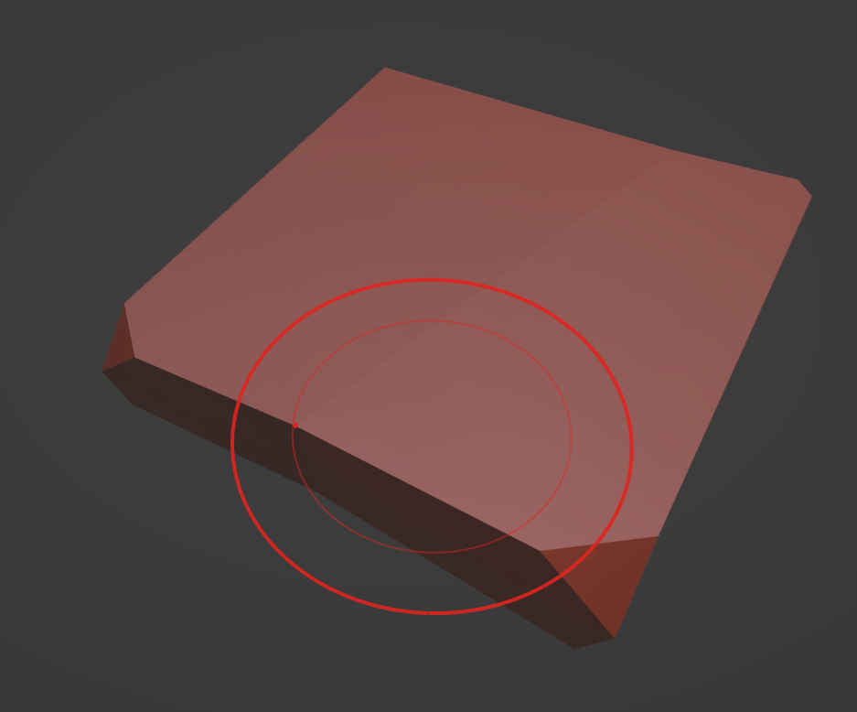
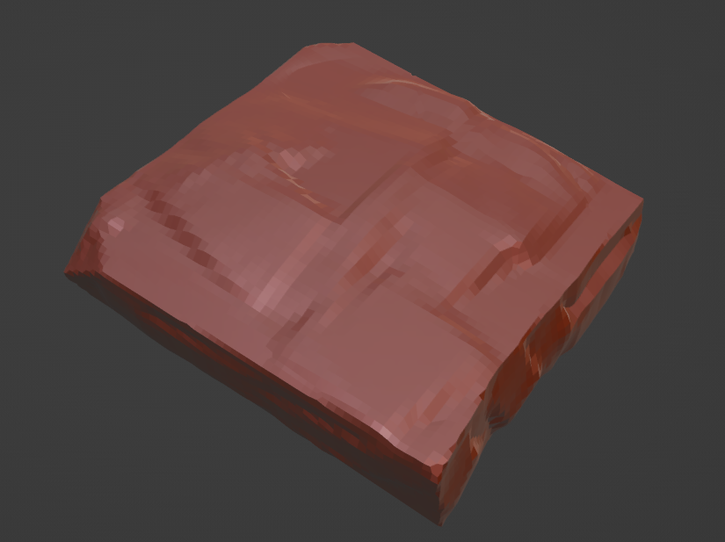
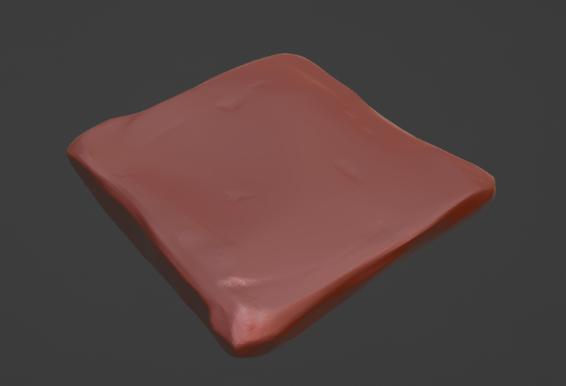
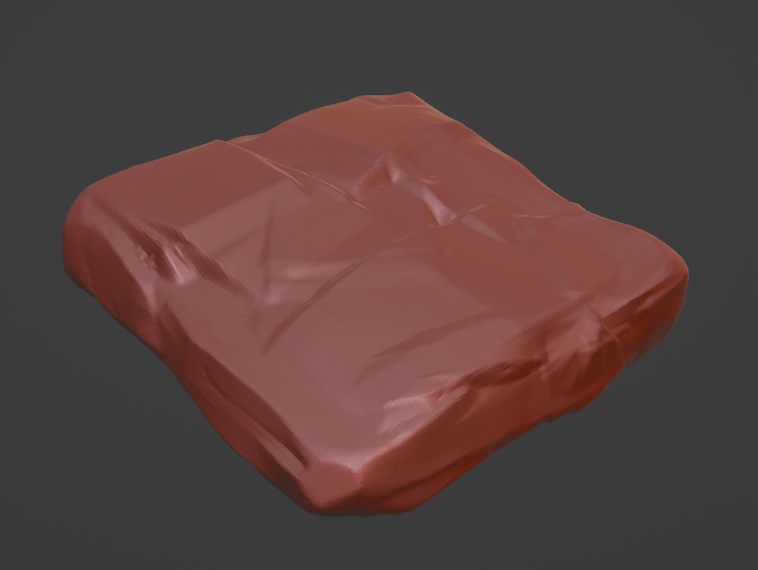
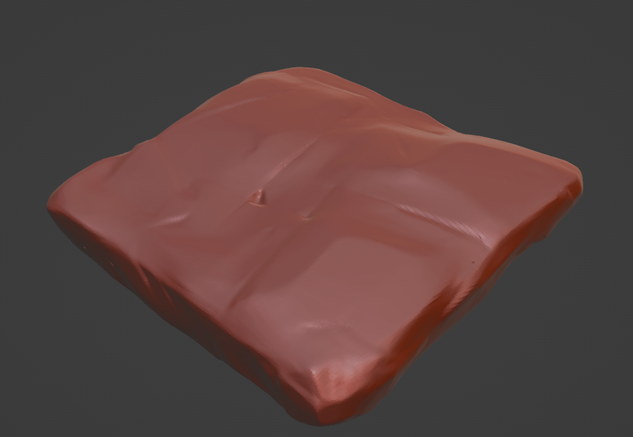
Sculpting Stylized Rock Faces
We use a combination of Clay Strips and the scrape tool to create the details on the rocks.
Adding clay, scraping away, remesh to higher res and repeat until the asset is complete.

